Slide 1
The Road to the White House Goes Through the Cloud How Data Will Decide the Next President
Ethan Chumley
Joel Cochran
Ashish Jaiman
Campaign Technology Services
Technology and Civic Engagement
Microsoft

Slide 2
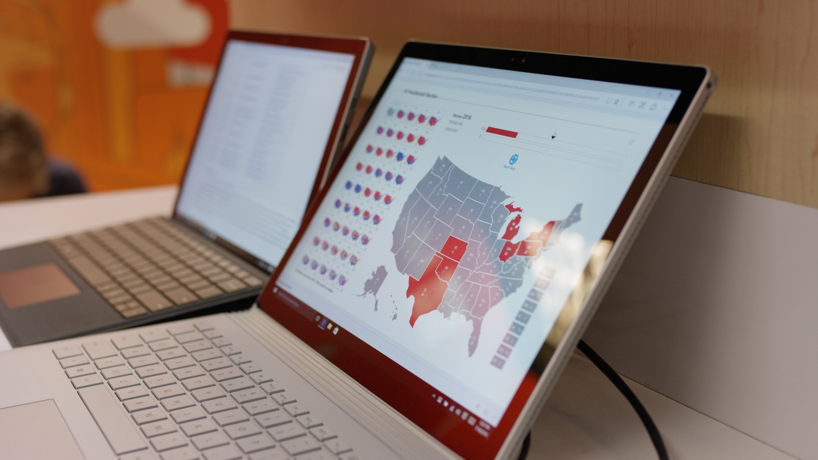
Notes:
A key objective for the team is to recruit 2016 Presidential campaigns, political committees, and key campaign technology and data vendors on to the Microsoft Azure platform

Slide 3


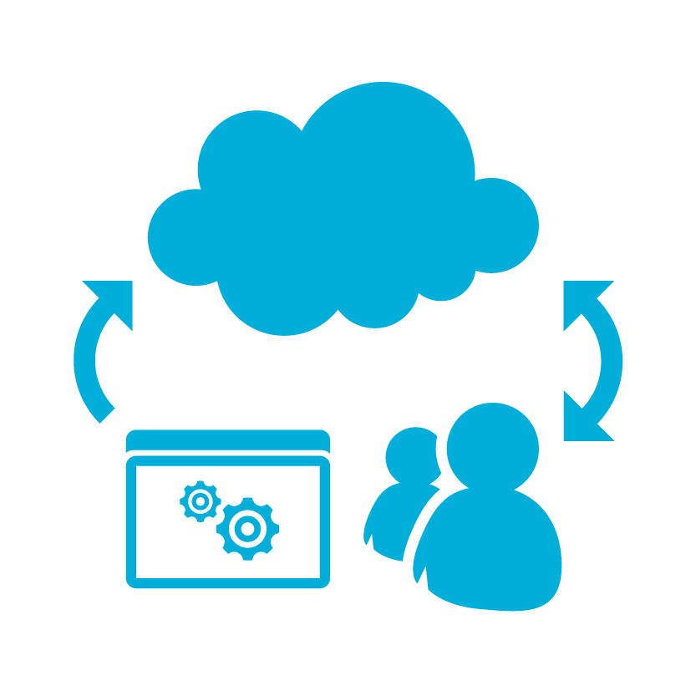
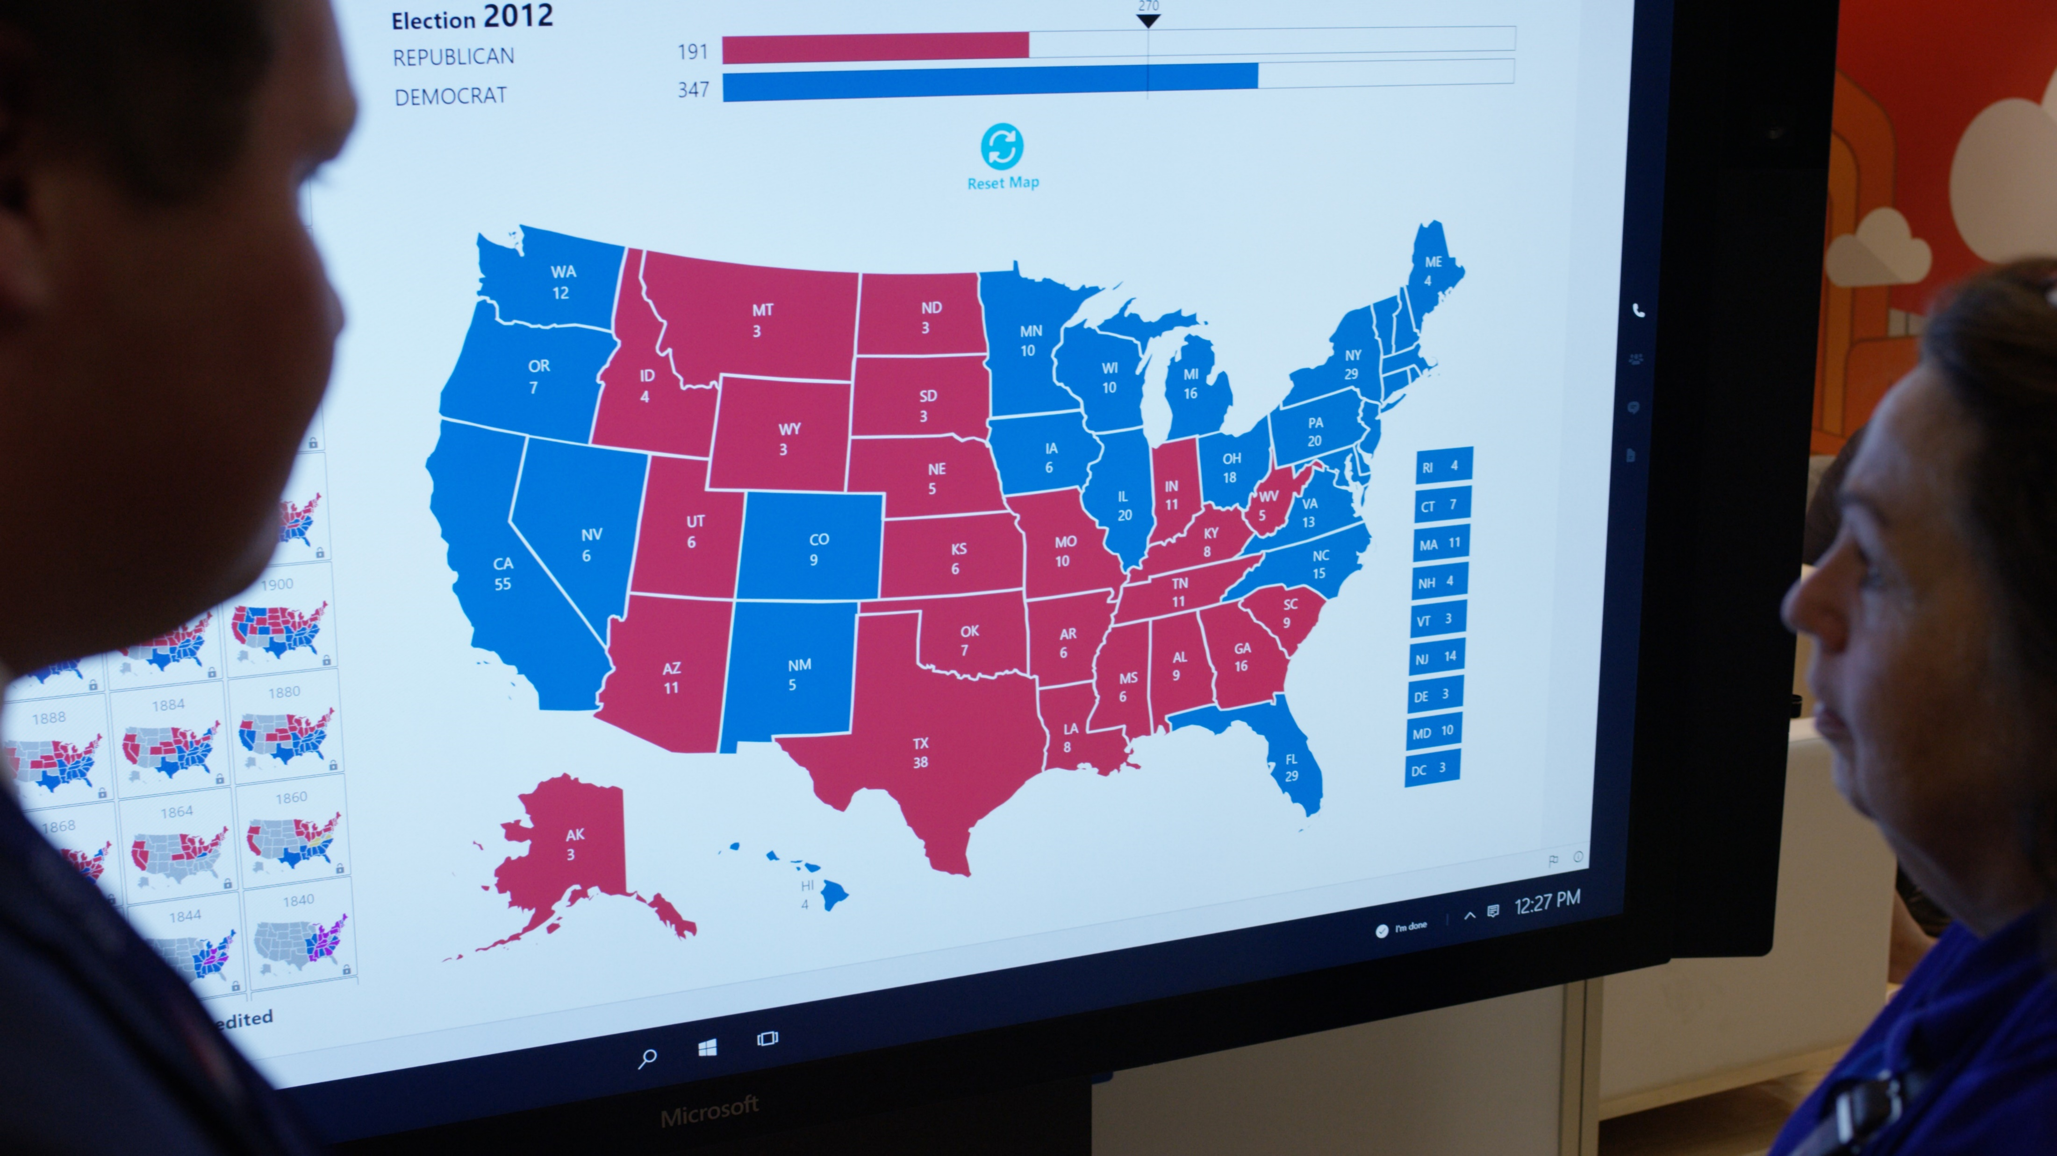



Why Microsoft?
Platform for Business Evolution
Technical
Architecture
Business Architecture
Domain Experts
Technical
Experts
Data & Analytics
Notes:
Win mindshare
Build relationship capital
Drive Microsoft platform adoption
A key objective for the team is to recruit 2016 Presidential campaigns, political committees, and key campaign technology and data vendors on to the Microsoft Azure platform
Understand an individual campaign’s needs, opportunities and challenges.
Identify and align appropriate Microsoft solutions, platform, and tools to help.
Bring technical and domain expertise to solve technical and data problems.
Work closely with existing campaign tech vendors to improve their solutions.
Serve as a sounding board for innovation.

Slide 4












Campaign Landscape

Slide 5
Campaign Structure
Analytics
Polling &
Testing
Comms & Strategy
Voter File
Management
Network
Management
(Field, Donors)
Finance &
Compliance
Data Management
Backbone (Internal Comms, Devices)
People
Notes:
Involved in all areas, but highlighted core competencies

Slide 6
Challenges and Opportunity
Startup-like Challenges
Rapid Scale Up and Down
Big Data & Analytics
Regulation and Compliance
Volunteer & Staff Management
Mobility
Security
Notes:
Enterprise solutions to startup challenges
Start up environment
“calendar driven” deadlines and dates – timing is inflexible

Slide 7
The Road to Iowa

Slide 8

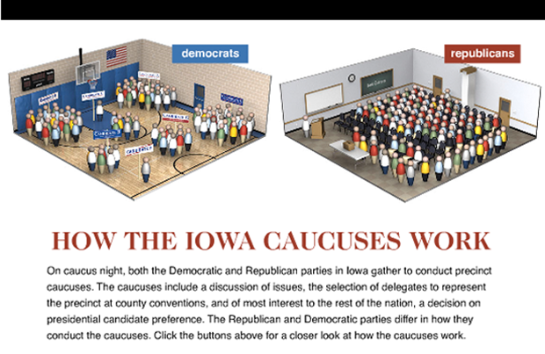
The Iowa Caucuses
Notes:
Explain a caucus, discuss the specific problems of 2012 that led to Microsoft’s involvement

Slide 9
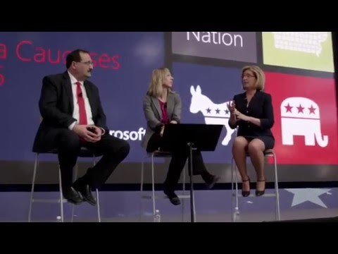
Notes:
Full video on Youtube: https://www.youtube.com/watch?v=463vNNhOJC4

Slide 10
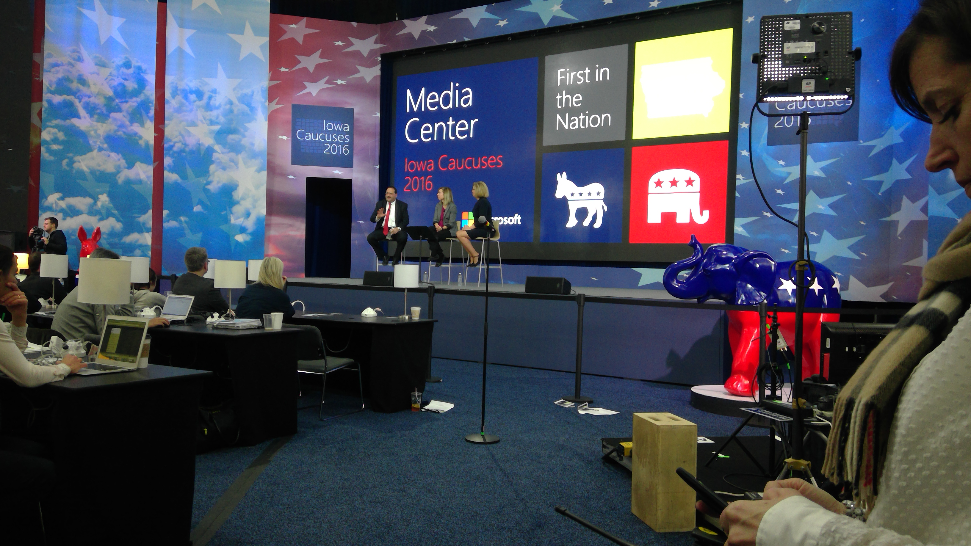
A Bipartisan Effort
Notes:
Explain a caucus, discuss the specific problems of 2012 that led to Microsoft’s involvement

Slide 11
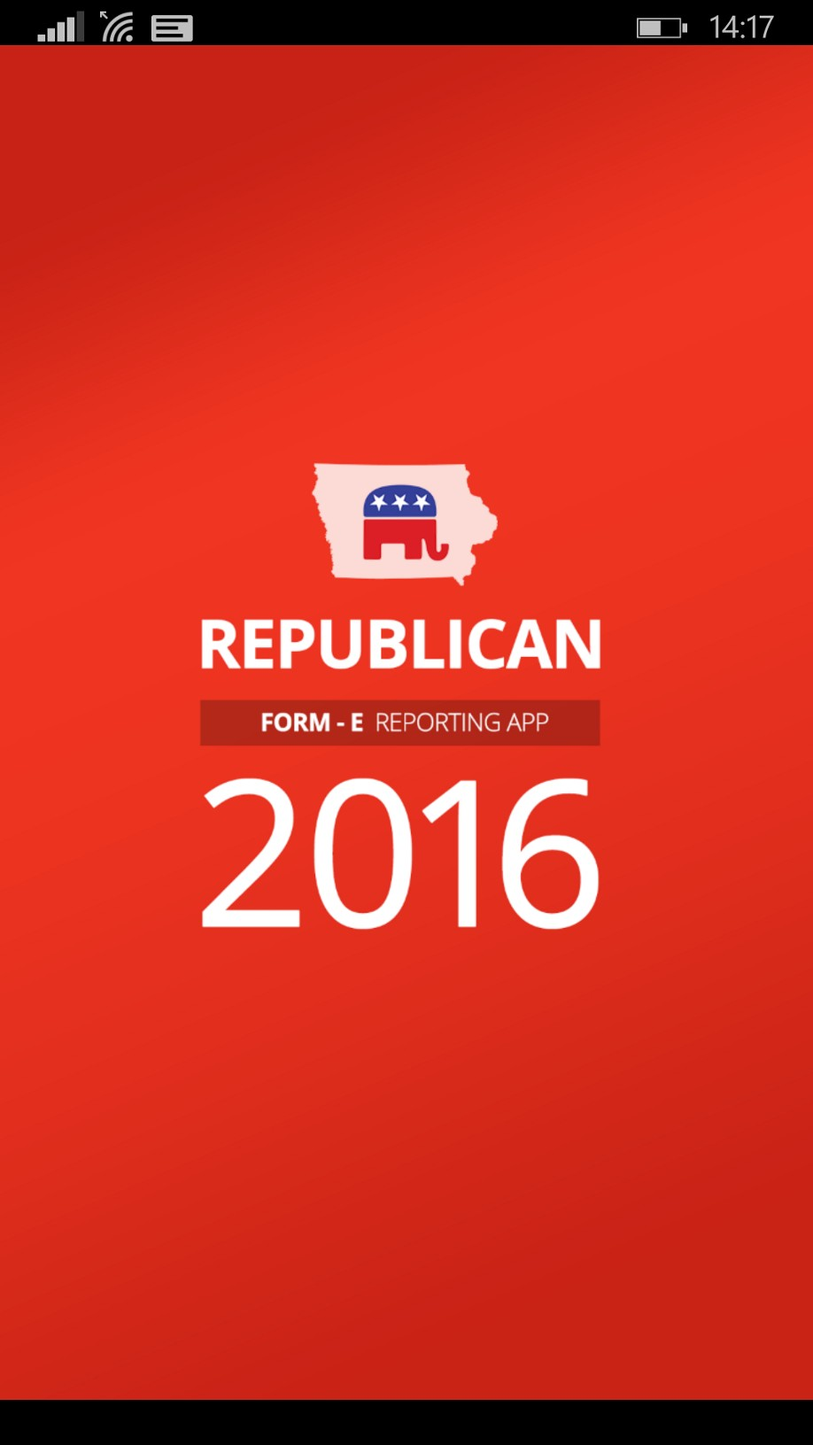
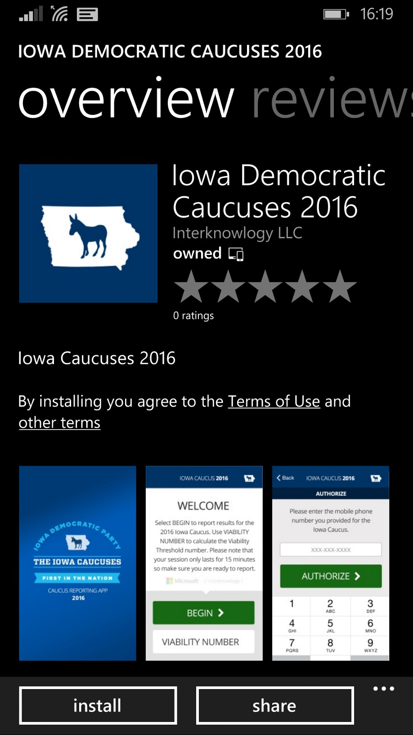
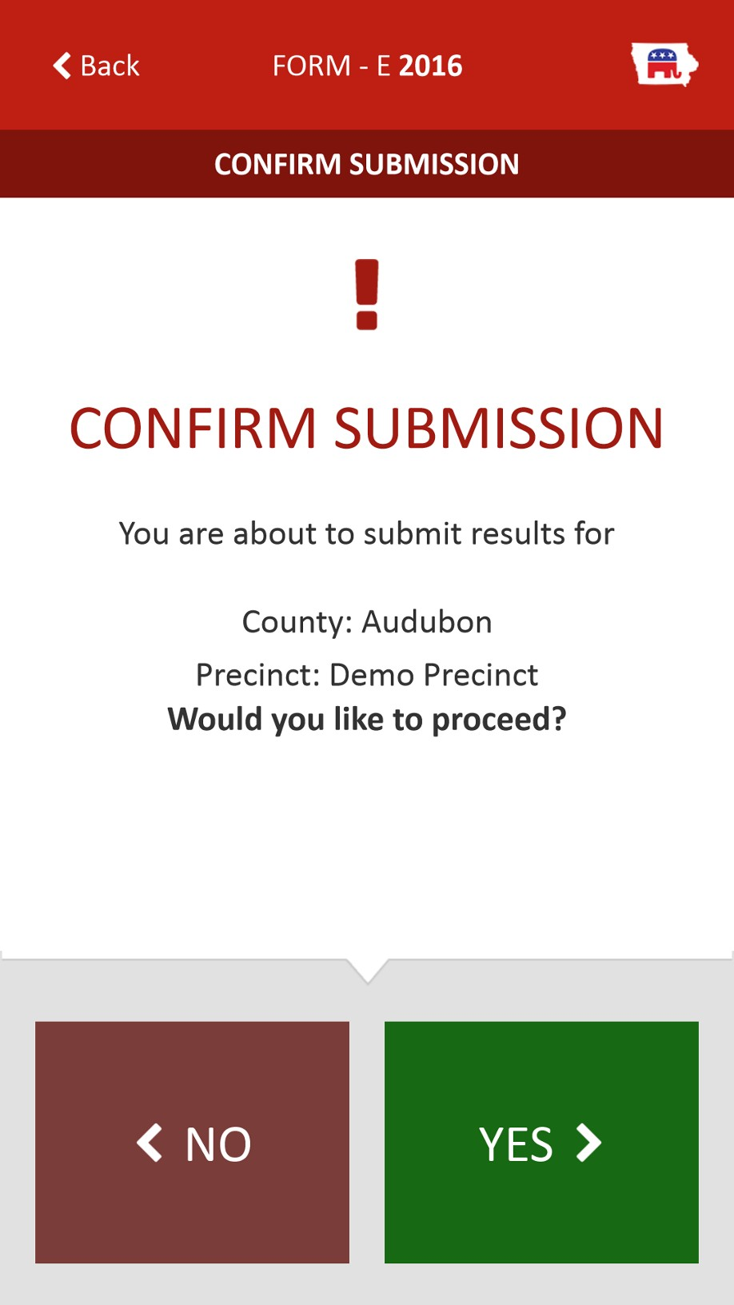
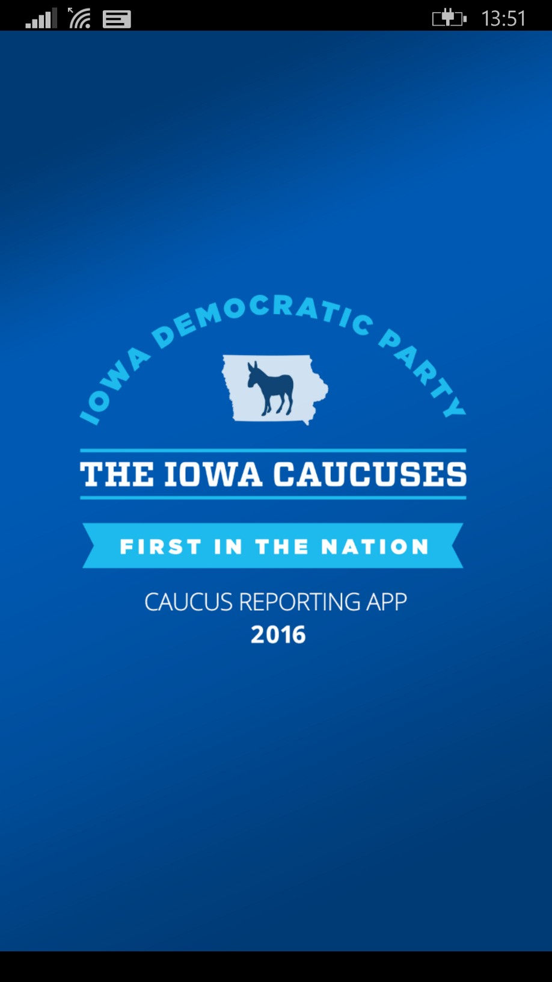
Precinct reporting

Slide 12
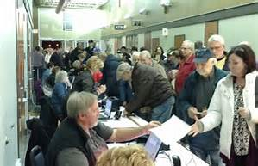
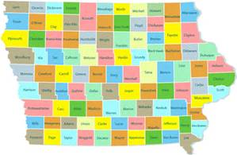
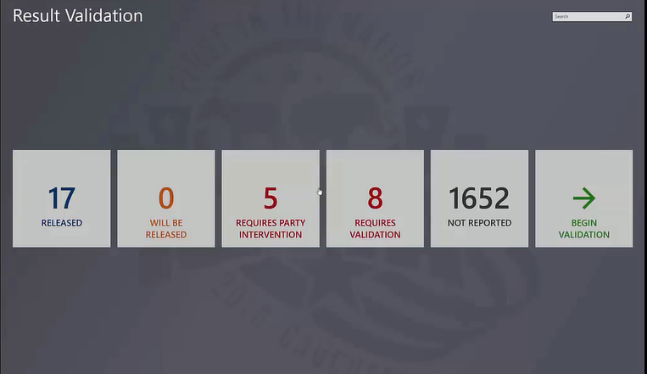
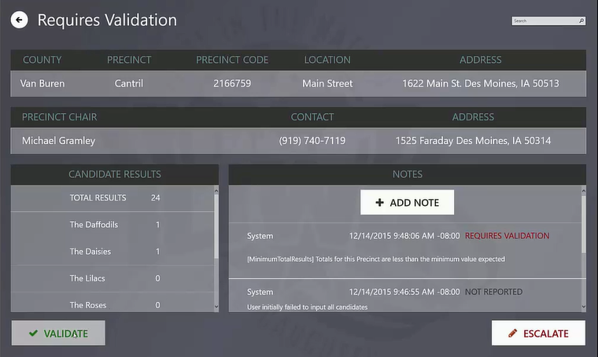
Collection and Verification
Notes:
Complexity and scale of the problem – 1718 precincts

Slide 13
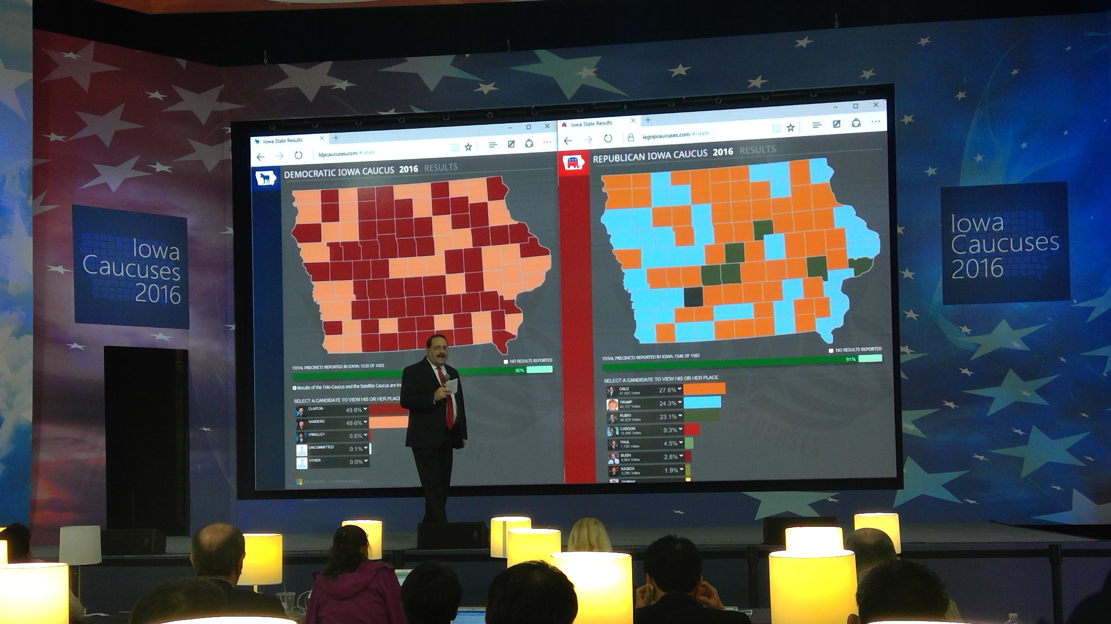
Results Release and Reporting

Slide 14


The Road to the Conventions

Slide 15
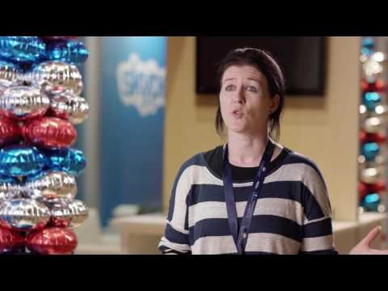
Notes:
2-min: https://www.youtube.com/watch?v=AsihICKHyi8
Full Length: https://www.youtube.com/watch?v=30NNSKdvgNA

Slide 16
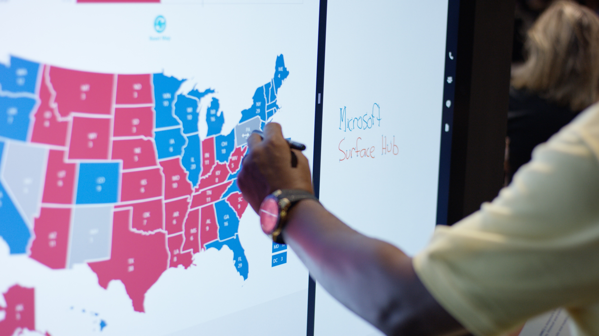
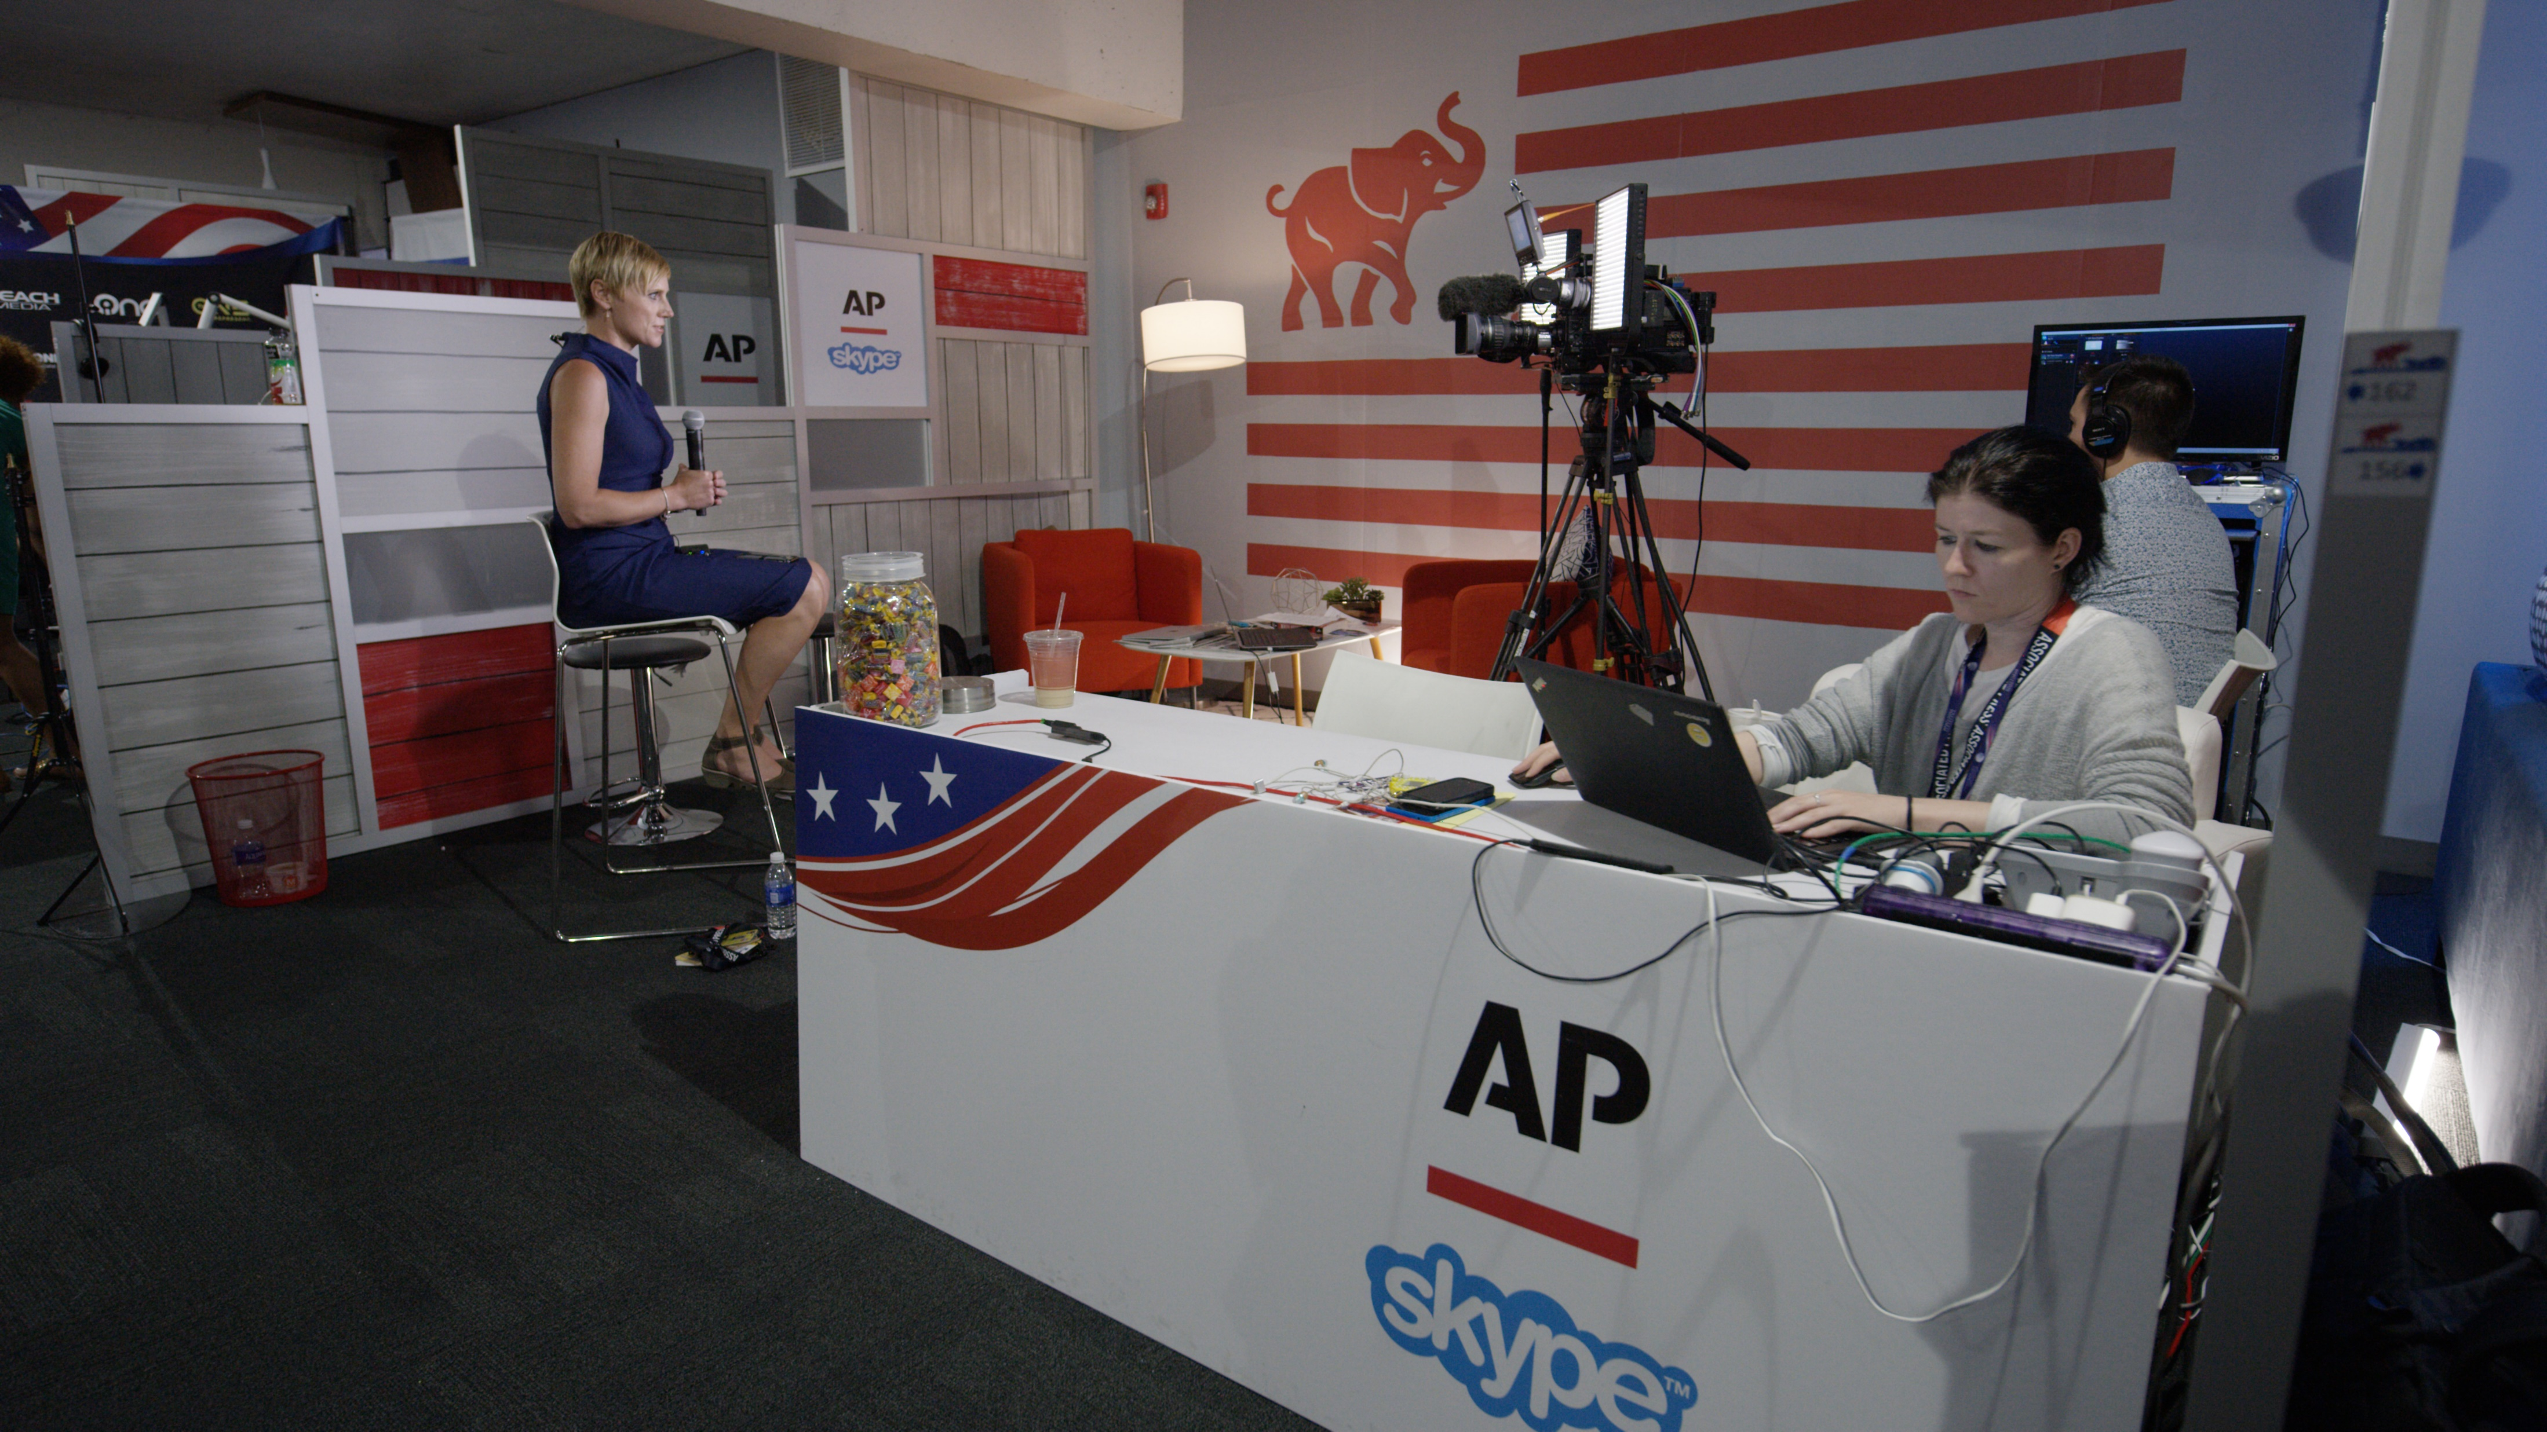
Republican National Convention
Official Technology Provider to the Committee on Arrangements:
Surface Hub, Surface Book, Surface Pros
Azure Infrastructure
Skype TX, Skype ViMs
Xbox Streaming
Dynamics CRM-OL
O365, Project, Visio
Host City Partnerships:
Citizen Service app with partner CitySourced for Cuyahoga County
Engagements with Cleveland Clinic and Case Western University

Slide 17
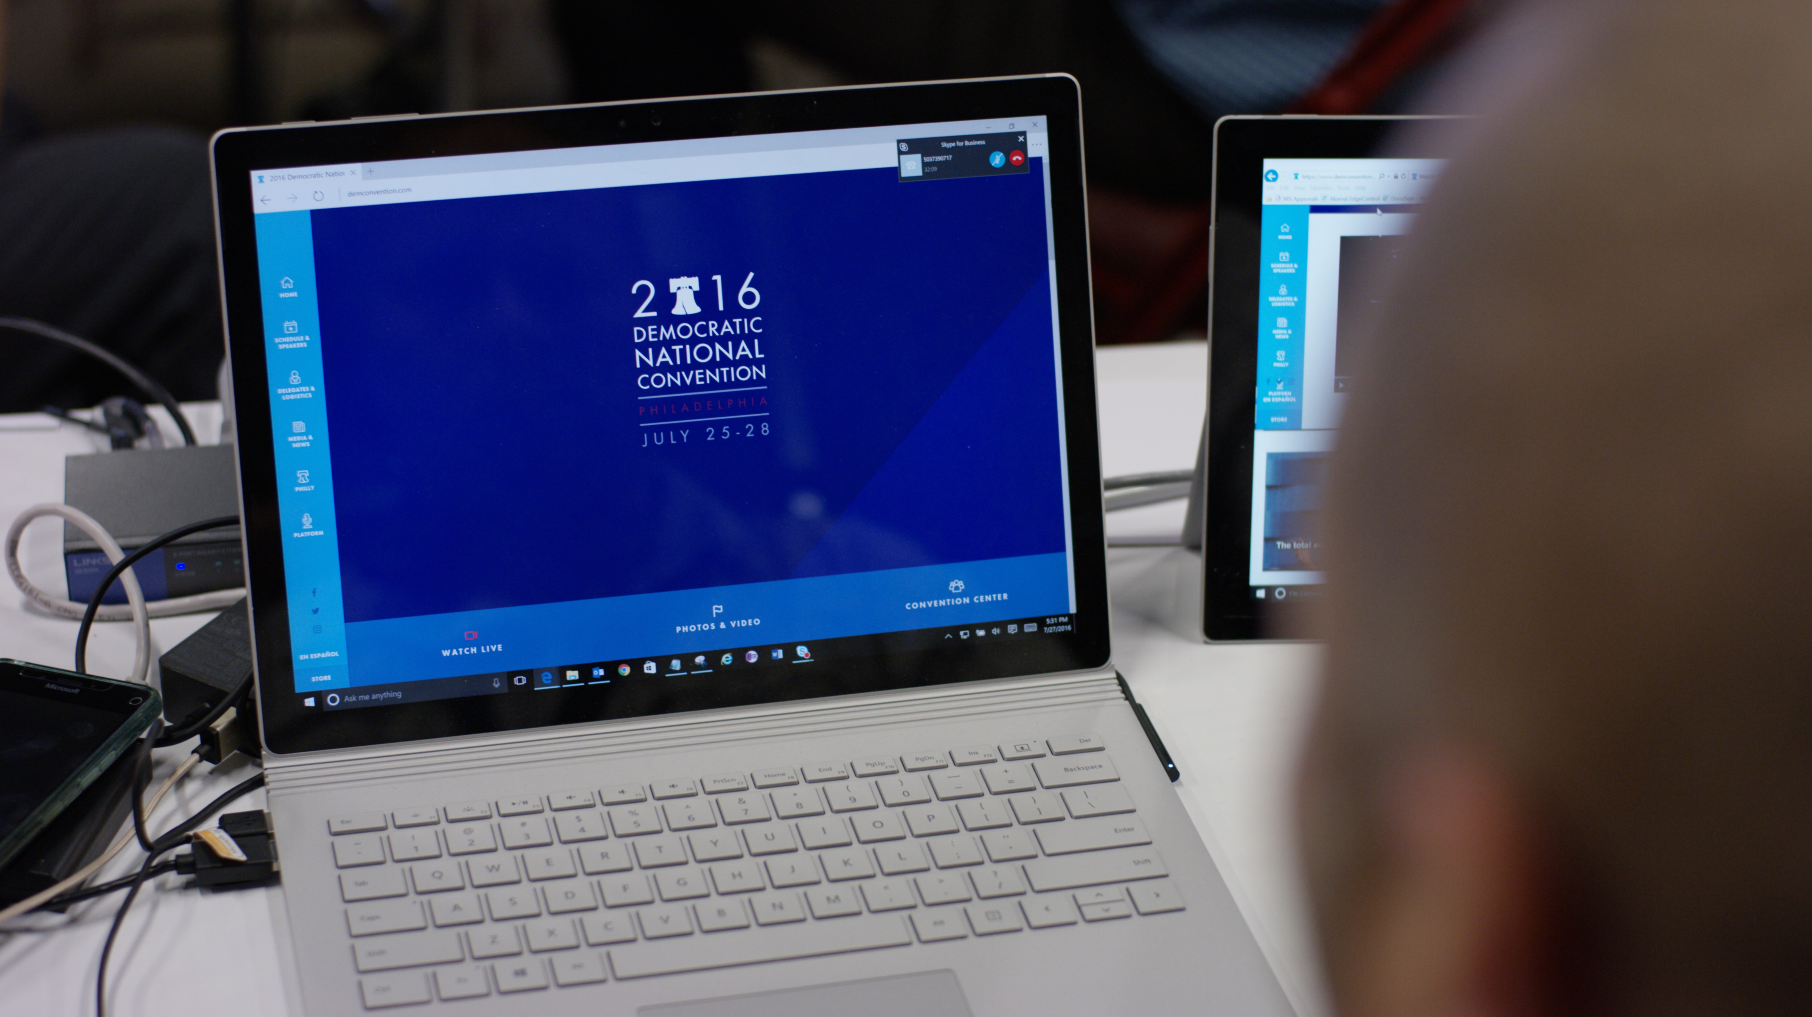
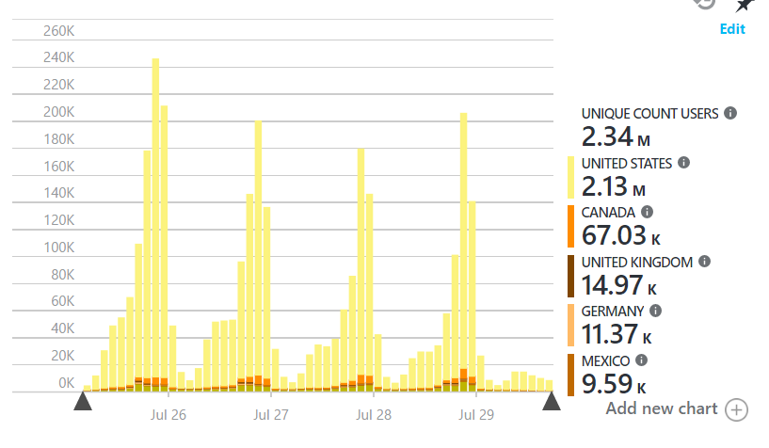
Democratic National Convention
Official Technology Provider to the DNCC:
Surface Hub, Surface Book, Surface Pros
Azure Video Streaming
Azure Web Hosting
Azure Infrastructure
Skype TX, Skype ViMs, main stage Skype interaction Thursday night
Xbox streaming
O365, Project, ATP
Host City Partnerships:
Microsoft Reactor in partnership with University Science Center
Citizenship engagements with Eagles Foundation and the City of Philadelphia

Slide 18
Microsoft Pulse

Slide 19
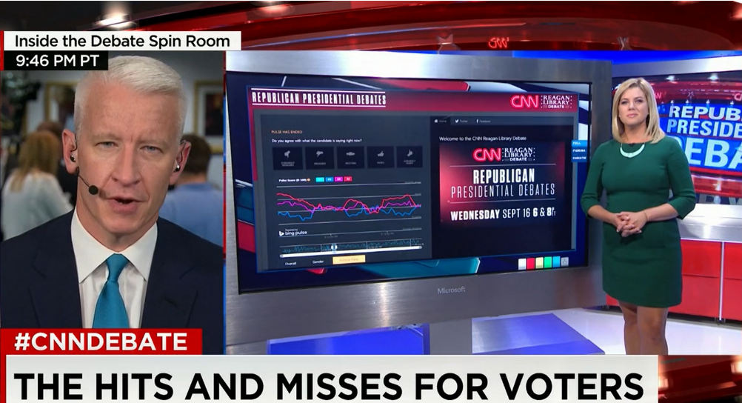
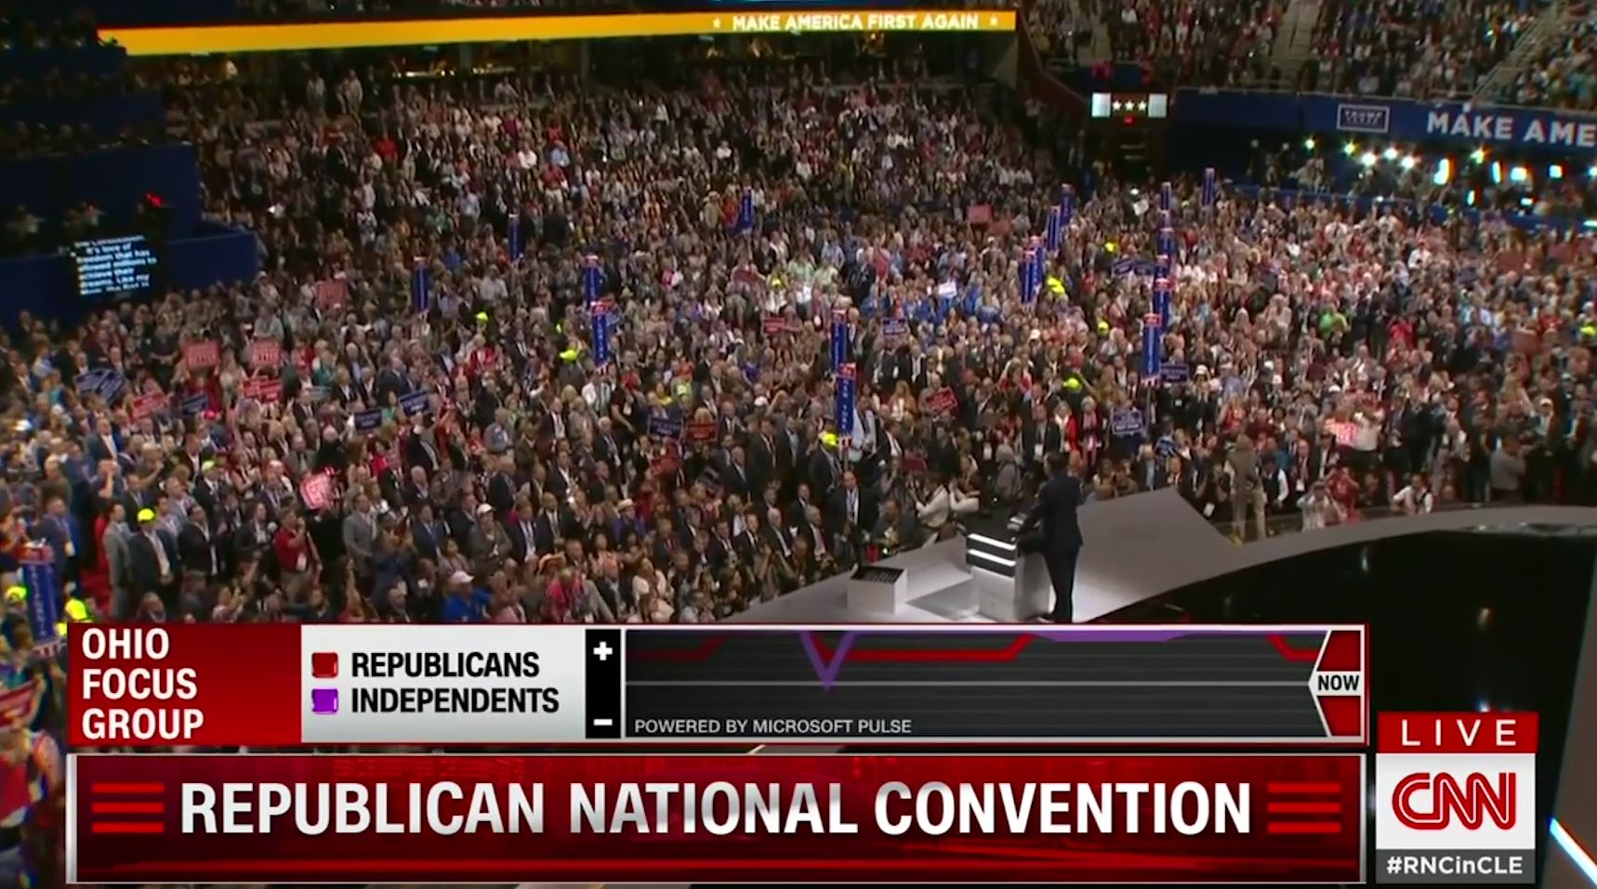
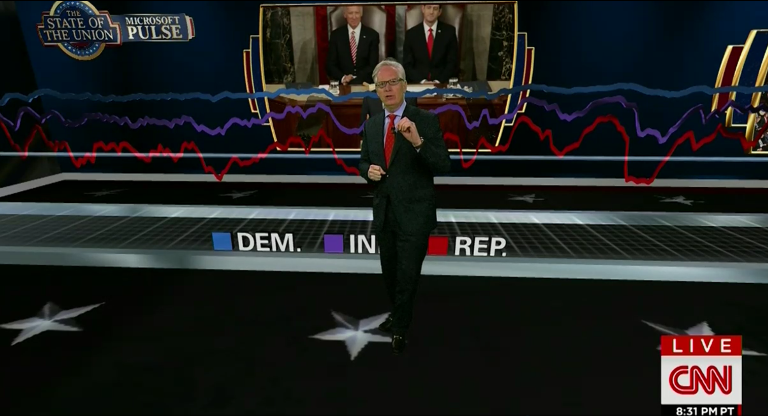
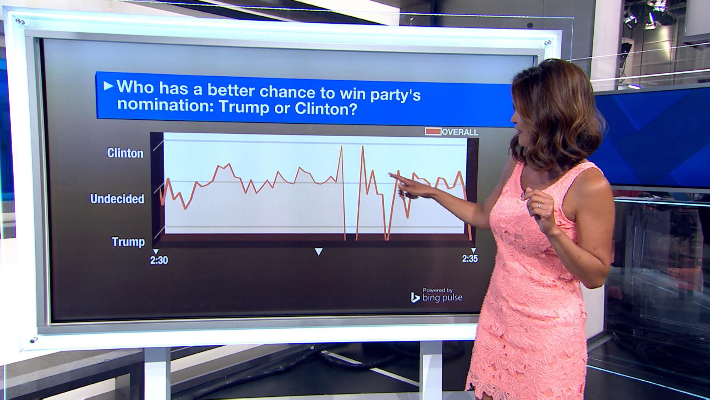
Pulse in the 2016 elections
Pulse has been used during on-air news coverage of the 2016 elections, prompting close to 10 million responses from hundreds of thousands of participants weighing in on issues surrounding the elections.
Pulse during the GOP debates (Sep 2015)
Pulse during the Republican Convention
Pulse during the 2016 SOTU address
Pulse on MSNBC daytime news coverage

Slide 20
Demo

Slide 21













Social Media
Streaming
Analytics
Event Hub
Analytics
Presentation
External Data
Data Factory
ETL
Azure Storage
API
Worker
Batch
Voter Files
Data Collection
Storage
Analysis / Management
Consumption

Slide 22
Working with Partners
Notes:
Transition from major events to the importance of partners and the usage of data and analytics tools.
The earlier events were specific moments in time, but not the campaigns. To help the campaigns, we work daily with partners that use data and analysis tools….

Slide 23
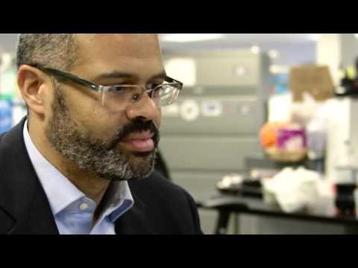
Notes:
2-min Video Youtube: https://www.youtube.com/watch?v=QZt82DFBtfc
Full video on Youtube: https://www.youtube.com/watch?v=felyeuaY_Yo

Slide 24


From The Basement to the Cloud - Before
Scattered Data
Manual Collection
Data “Exploration”
Heroics
Gymnastics
Contortions
Confusion
Transient Conditions
Never the same data twice
ccgBI.com
Notes:
What It Was
Data all over the place
On Premise
Hosted
AWS
Spreadsheets
Special Processes
Often, a person’s ability to acquire and shape data was what made them important to the organization
Heros
Gymnasts
Contortionists
Never the same answer twice
Very difficult to assemble data to extract meaning
Challenge
300 TB data Voter Registration Data All Scattered Around
Add Census Data
Add consumer data points
Over 50% turnover of staff every year
Most are starting from scratch every election cycle
New audiences every cycle
Only a few people left behind year over year
Keep the light ons
All new hires after 3 years of idleness
Blend of on premise, hosted, and other transient data sources.

Slide 25
From The Basement to the Cloud - After
ccgBI.com
Notes:
Into this environments, how to make this easier and more accessible
Using a mix of Consumer Data, Contact Information, And Voter Scores
To Answer 3 Questions:
How likely are you to vote?
How likely to vote for this issue/candidate
Can you be persuaded?
Change the Conversation
2016 not like 2012
Voter information at State level at the user's fingertips.
Instead of saying "how do I" the questions changed to
What if?
What does this signify?
How do we change this?
Explore and position

Slide 26

NGP VAN is the leading technology provider to Democratic and progressive campaigns and organizations, offering clients an integrated platform of the best fundraising, digital, and organizing products.
Notes:
NGP VAN works with everyone up and down the ticket from Presidential campaigns to small local races. We provide crucial infrastructure to the Democratic National Committee, and also work directly with local candidates to provide affordable websites and email packages.

Slide 27

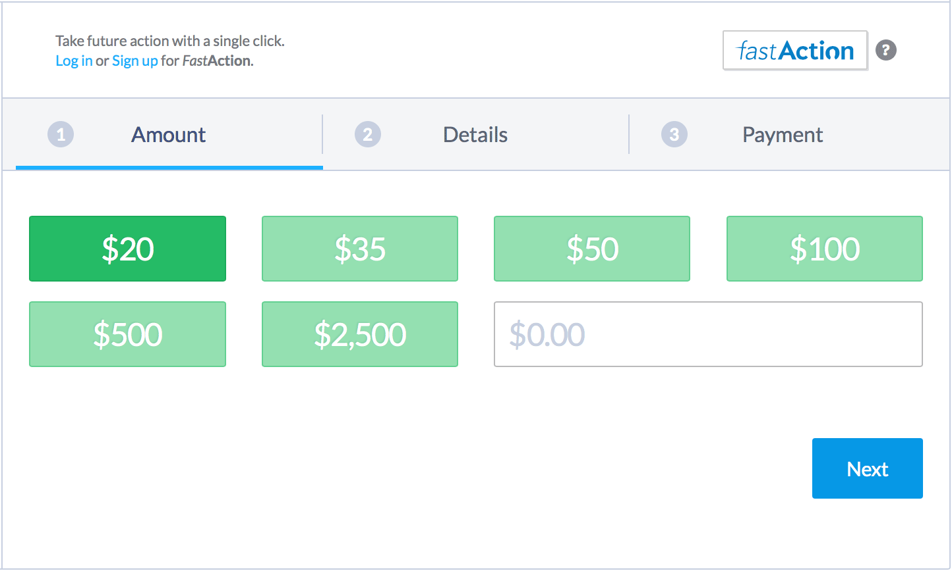
Best Ask
Customized ask amounts for the individual
NGP VAN’s donor network of ActionProfiles
+
Microsoft’s Cognitive Services Recommendation API
Notes:
Best Ask is uses Cortana - Microsoft’s Cognitive Services Recommendation API – to provide a customized ask amount for the individual
Leverages NGP VAN’s network of ActionProfiles, which remembers donors when they visit NGP VAN donation pages
Using ActionProfile data, we are able to ask Cortana to generate ask amounts for new visitors based on other users who give alike
In the weeds
”U2I – User to Item” type, where we’re modeling past donations as ”usage” and preset ask amounts as “catalog items”
API is very robust and well documented
Very excited about early results
Next, using the Text Analytics API to detect topics from user entered form text to add another semantic dimension for making more relevant recommendations

Slide 28
Questions?

